Slide 1

Text Mining Techniques
Chapter 3

Slide 2
Text Mining using NLP
Text Pre-Processing
Text Cleaning
Handling missing data and noise in web datasets
Keyword Extraction
TF-IDF
RAKE
Named Entity Recognition (NER)
Text Classification and Clustering
Sentiment Analysis
Text Summarization
Topic Modeling
Dependency Parsing

Slide 3
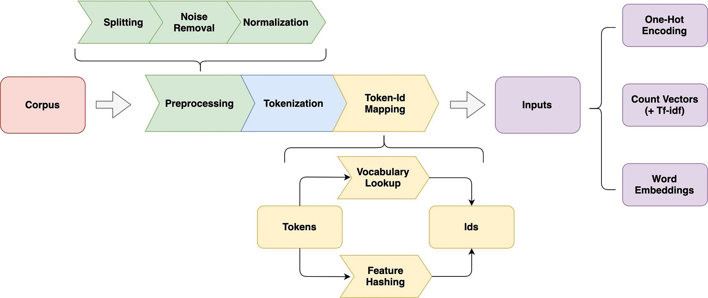

Slide 4
Text Pre-processing
Before analyzing web content, it's essential to preprocess the text. This includes tasks such as
Tokenization
Removing stop words
Stemming or lemmatization
Normalization
Remove whitespaces
Remove Punctuation
Handling special characters or HTML tags
Removing Duplicates
Handling Missing Values
Spell Checking
Data Encoding
Part-of speech tagging
Data Sampling and Balancing
Preprocessing ensures that the text is in a suitable format for further analysis.

Slide 5
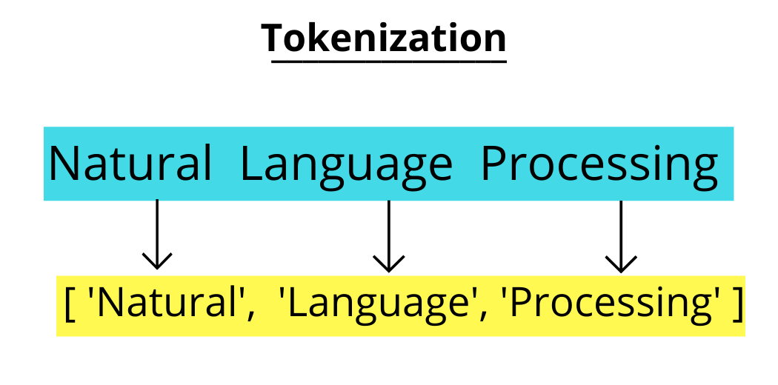
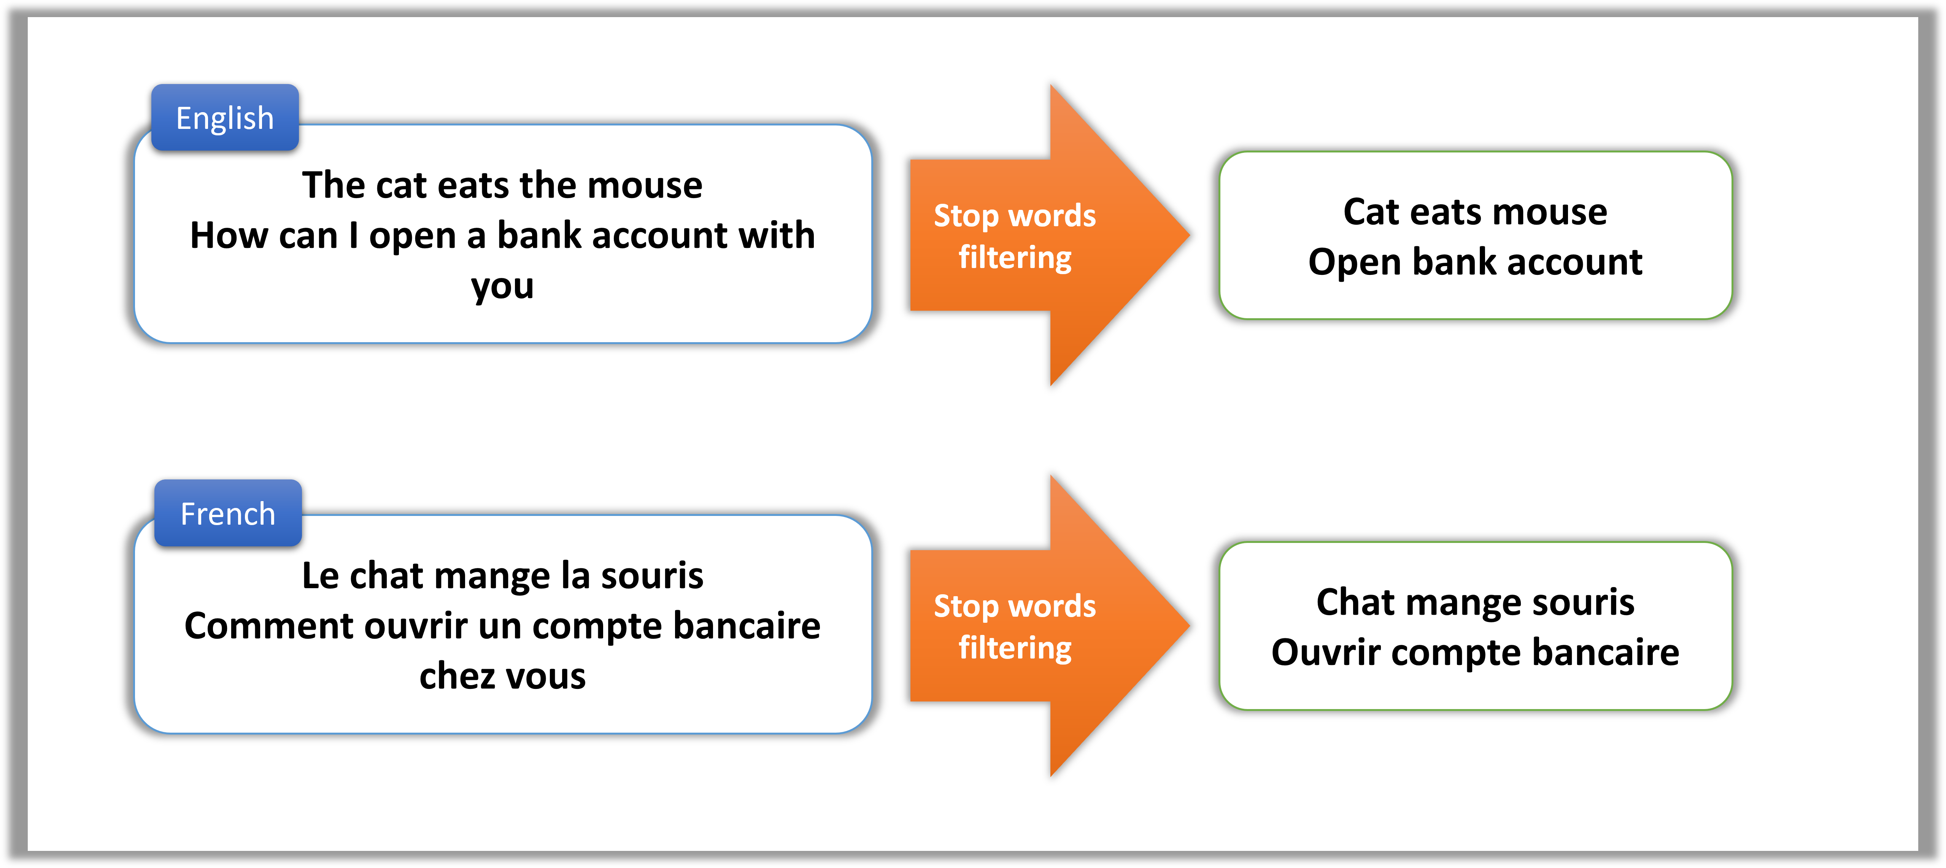
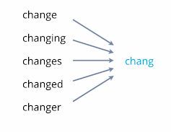
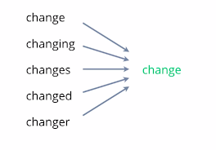
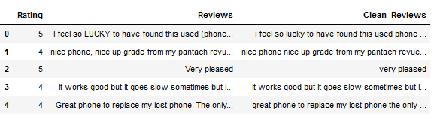
Removing Stop words
Stemming
Lemmatization
Text Normalization

Slide 6
Part-of-Speech Tagging
Part-of-speech (POS) tagging assigns grammatical tags to words in a sentence, indicating their syntactic roles (e.g., noun, verb, adjective). POS tagging helps in understanding the grammatical structure of web content, which is essential for tasks like information extraction, sentiment analysis, or text summarization.
[('Sukanya', 'NNP'), ('Rajib', 'NNP'), ('Naba', 'NNP'), ('good', 'JJ'), ('friends', 'NNS')] [('Sukanya', 'NNP'), ('getting', 'VBG'), ('married', 'VBN'), ('next', 'JJ'), ('year', 'NN')] [('Marriage', 'NN'), ('big', 'JJ'), ('step', 'NN'), ('one', 'CD'), ('’', 'NN'), ('life', 'NN')] [('It', 'PRP'), ('exciting', 'VBG'), ('frightening', 'VBG')] [('But', 'CC'), ('friendship', 'NN'), ('sacred', 'VBD'), ('bond', 'NN'), ('people', 'NNS')] [('It', 'PRP'), ('special', 'JJ'), ('kind', 'NN'), ('love', 'VB'), ('us', 'PRP')] [('Many', 'JJ'), ('must', 'MD'), ('tried', 'VB'), ('searching', 'VBG'), ('friend', 'NN'), ('never', 'RB'), ('found', 'VBD'), ('right', 'RB'), ('one', 'CD')]

Slide 7
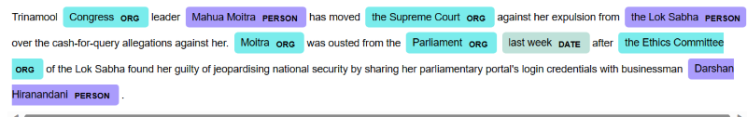
Named Entity Recognition
NER identifies and classifies named entities such as names of people, organizations, locations, dates, and more within the text. This is useful for extracting key entities mentioned in web content, which can be valuable for various applications such as entity linking, sentiment analysis, or information retrieval.

Slide 8
Cleaning
Handling missing data and noise in web datasets is crucial to ensure the accuracy and reliability of analyses. Here are some techniques to address these issues:
1. **Identify Missing Data**:
- Begin by identifying missing values within the dataset. Missing values can manifest in various forms, such as empty fields, placeholders (e.g., "N/A", "-"), or NaN (Not a Number) values.
2. **Imputation**:
- Imputation involves filling in missing values with estimated or inferred values. Common imputation techniques include:
- Mean, median, or mode imputation: Replace missing values with the mean, median, or mode of the respective column.
- Forward fill or backward fill: Propagate the last known value forward or the next known value backward to fill missing values.
- Regression imputation: Predict missing values using regression models based on other correlated variables.
- K-nearest neighbors (KNN) imputation: Replace missing values with the average of the nearest neighbors' values.
- Imputation with algorithms like MICE (Multiple Imputation by Chained Equations) which considers the relationships between variables.
3. **Dealing with Categorical Data**:
- For categorical variables, consider imputation techniques tailored for categorical data. One approach is to replace missing values with the mode (most frequent value) of the respective category.
4. **Data Smoothing and Filtering**:
- Apply data smoothing techniques to reduce noise in the dataset. Techniques like moving averages, exponential smoothing, or median filtering can help smooth out irregularities caused by noise.
- For textual data, consider techniques like spell checking, stemming, or lemmatization to reduce noise caused by spelling errors or variations in word forms.
5. **Outlier Detection and Removal**:
- Identify outliers in the dataset that may be indicative of noisy or erroneous data points. Outlier detection techniques such as z-score, IQR (Interquartile Range), or clustering-based methods can help identify and remove outliers.
- Exercise caution when removing outliers, as they may contain valuable information or represent legitimate data points.
6. **Data Quality Assessment**:
- Conduct a comprehensive assessment of data quality to identify and address potential issues. This may involve examining data distributions, checking for inconsistencies or anomalies, and verifying data integrity.
- Utilize visualization techniques such as histograms, box plots, or scatter plots to visually inspect the data and identify patterns or irregularities.
7. **Robust Modeling Techniques**:
- Use modeling techniques that are robust to noise and missing data. For example, ensemble methods like random forests or gradient boosting are known to handle missing values effectively.
- Consider techniques such as cross-validation to evaluate model performance in the presence of missing data.
8. **Data Collection Improvement**:
- Improve data collection processes to minimize missing data and noise in future datasets. This may involve refining data collection methods, implementing data validation checks, or enhancing data quality control measures.
By employing these techniques, analysts can effectively handle missing data and noise in web datasets, leading to more accurate and reliable analyses and insights.

Slide 9
Keyword Extraction
Keyword extraction identifies important terms or phrases in the text. Keyword extraction identifies important terms or phrases in web content. This helps in summarizing the main topics discussed in the content and can be useful for tasks like search engine optimization (SEO), content analysis, or topic categorization.
There are different techniques to find keywords in the text
TF-IDF (Term Frequency Inverse Document Frequency)
RAKE (Rapid Automatic Keyword Extraction)

Slide 10
Text Classification
Text classification categorizes web content into predefined categories or labels. This can be useful for tasks like topic classification, spam detection, sentiment analysis, or content filtering. Machine learning algorithms such as Naive Bayes, SVM, or deep learning models can be applied for text classification.

Slide 11
Named Entity Disambiguation
In cases where named entities are ambiguous (e.g., same name referring to different entities), named entity disambiguation techniques can be applied to resolve the ambiguity and link entities to their respective entities in a knowledge base.

Slide 12
Topic Modeling
Topic modeling identifies topics or themes present in web content. Techniques like Latent Dirichlet Allocation (LDA) or Non-Negative Matrix Factorization (NMF) can be used to discover latent topics within web pages, enabling content categorization, trend analysis, or recommendation systems.

Slide 13
Sentiment Analysis
Sentiment analysis determines the sentiment (positive, negative, or neutral) expressed in web content. This is valuable for understanding public opinion, customer feedback, or brand sentiment on the web. Sentiment analysis techniques range from rule-based methods to machine learning approaches using techniques like Naive Bayes, Support Vector Machines (SVM), or deep learning models.

